Slide 1
Binary Adder

Slide 2
Binary Adder
Most Basic arithmetic function is Addition of two binary digits
0+0=0,
1+0=1,
0+1=1,
1+1=10 (Carry is added to the next higher order pair of significant values)
A combinational circuit that performs addition of two bits is called Half Adder
A combinational circuit that performs addition of three bits is called Full Adder (Adding two half adder)

Slide 3
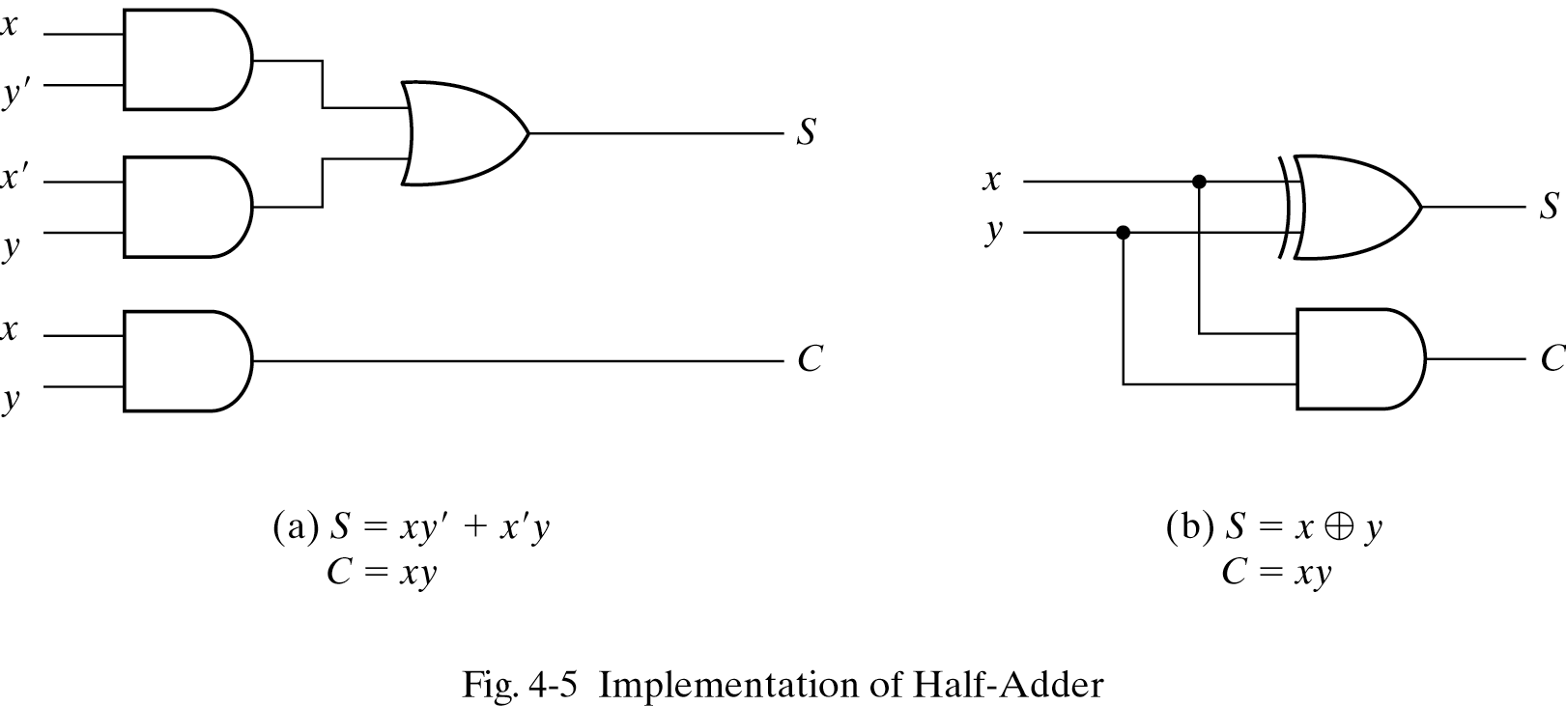
Half Adder
Adds two one-bit binary numbers (A and B) and outputs a sum (S) and a carry (C).
X
Y
S
C
0
0
0
0
1
0
1
0
0
1
1
0
1
1
0
1
XOR
AND

Slide 4
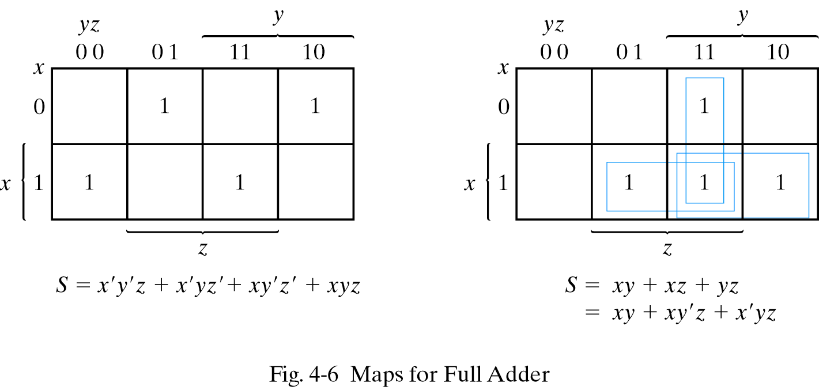
Full Adder
INPUTS
OUTPUTS
Adds three one-bit binary numbers (A, B, C) and outputs two one-bit binary numbers, a sum (S) and a carry (C1).
Inputs
Outputs
x
y
z
S
C
0
0
0
0
0
0
0
1
1
0
0
1
0
1
0
0
1
1
0
1
1
0
0
1
0
1
0
1
0
1
1
1
0
0
1
1
1
1
1
1
C
Notes:
K-maps of S shows checkboard configuration. Hence it is X XOR Y XOR Z

Slide 5
Full Adder

Slide 6
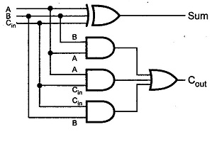
Full Adder
C = XY + YZ + XZ

Slide 7
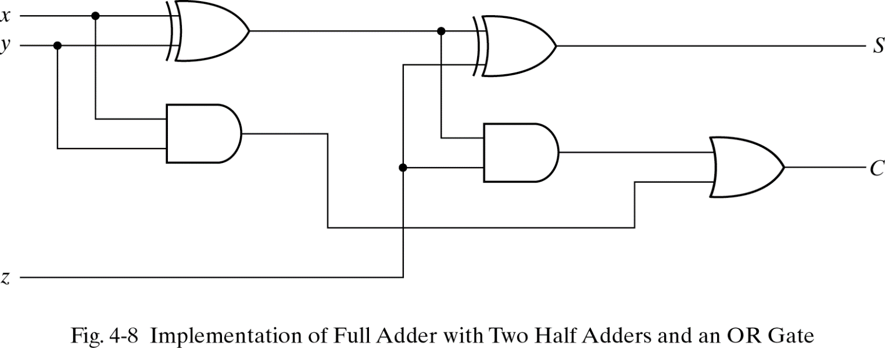
Implementing Full Adder with two half Adders
C = XY + YZ + XZ
= XY + XY’Z + X’YZ
= XY + Z(X + Y)
C

Slide 8
Binary Subtractor

Slide 9
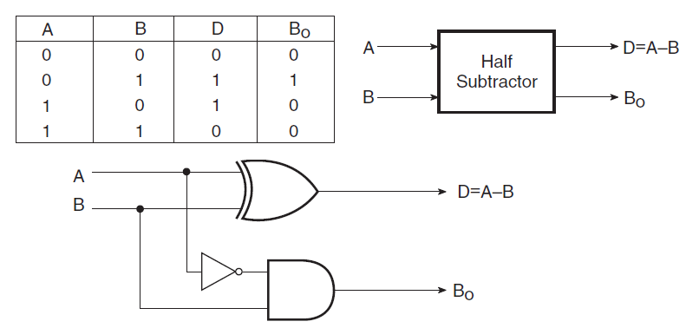
Half Subtractor
Subtraction of unsigned binary numbers can be done using complements.
D = A XOR B
Bo = A’B

Slide 10
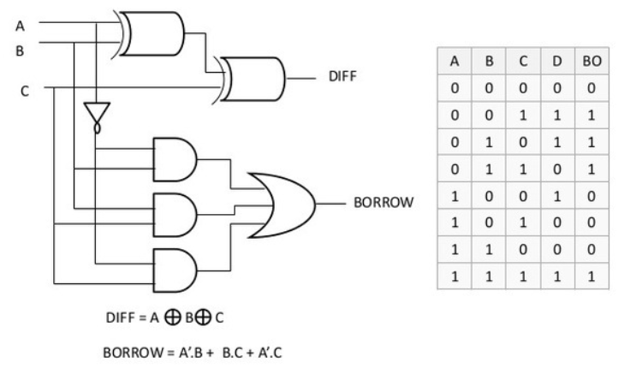
Full Subtractor

Slide 11

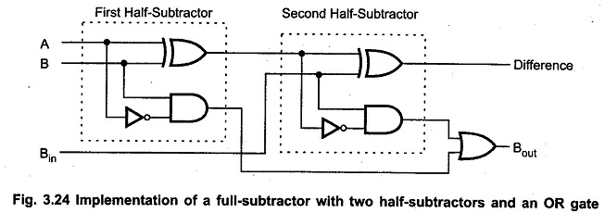
Full Subtractor
Like carry in full adder, borrow of full subtractor also takes the form of

